Slide 1
Midterm Review

Slide 2
Q1. (Fall 2024 Midterm). A 400-MW power plant burning biogas is to be installed with an initial cost of $900 million. The operating and maintenance expenses are $400,000 per year while the staff cost is $8 million per year. The plant has an availability of 84.2%. The overall efficiency of the plant is 45% and the unit cost of biogas is $1.1/therm where 1 therm = 100,000 Btu = 105,500 kJ = 29.31 kWh. The lifetime of the plant is expected to be 30 years. Taking the annual interest rate to be 4.5 percent, determine a) annual biogas cost, and b) the levelized cost of electricity (LCOE) from this power plant.

Slide 3
Q2. (Fall 2023 Midterm). Air enters the compressor of an air-standard Brayton cycle with a volumetric flow rate of 90 m³/s at 85 kPa, 290 K. The compressor pressure ratio is 18, and the maximum cycle temperature is 2050 K. Assume that the combustor has an efficiency of 90%. Assume turbine and compressor are isentropic (i.e., ideal cycle), but the actual efficiency of the cycle 80% of the ideal cycle. Determine
the net power developed, in MW.
the rate of heat addition in the combustor, in MW.
the thermal efficiency of the cycle.
the rate of natural gas required to the combustor.
the rate annual CO₂ generation by the plant if the plant has an availability of 80% through the year

Slide 4
Q3. (Fall 2023 Midterm) A coal fired steam power plant operating on a simple Rankine cycle operates with the following conditions: steam produced by the boiler is at 8 MPa and 450 C. Condenser operates at 15 kPa and mass flow rate of water through the boiler is 20 kg/s. Assume isentropic efficiencies of 80% for both pump and steam turbine. Determine:
the power produced by the turbine, required by the pump and the resulting net power developed, in MW.
rate of heat required to the boiler in MW
the thermal efficiency of the cycle.
Yearly coal consumptions in short tons of coal
Yearly CO2 emission of the plant in metric tons of C2

Slide 5
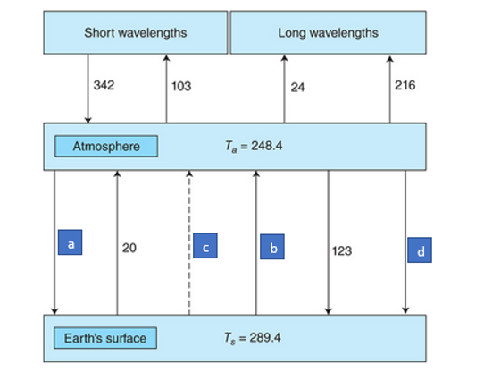
Q4. (Fall 2022 Midterm). Determine how the energy flows shown as a, b, c, and d change if the transmittance through atmosphere in short wavelength reduced to 40% from 53% and the transmittance through the atmosphere in long wavelength reduces to 0.04 from 0.06. All other parameters remain the same. Provide equilibrium earth and atmosphere temperatures

Slide 6
Q5. A high has installed a new 80 RT air conditioning unit with SEER of 13 and is interested in finding the yearly electricity cost of the unit, the yearly emission of the unit if 60% of the electricity in Ontario is produced through clean, emission free sources and the remaining 40% is produced through natural gas power plants. The unit is estimated to run approximately 850 hrs/year and the electricity charge is 0.14 $/kWh

